Slide 1





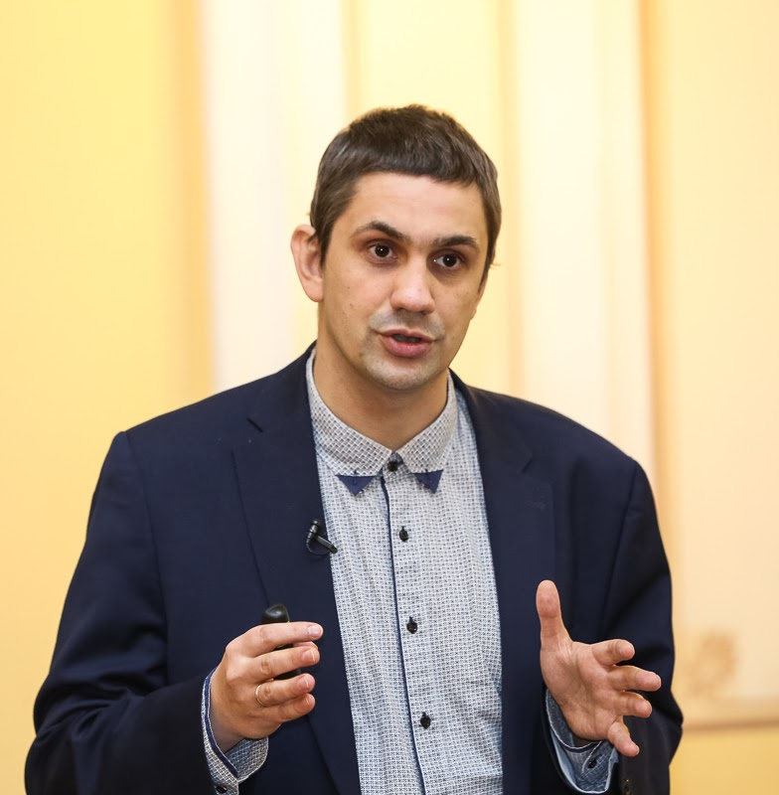
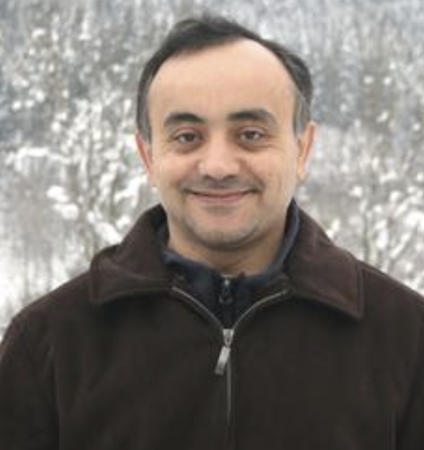

Propagating terrace in a semi-discrete model of Incompressible Porous Medium (IPM) equation
Yulia Petrova PUC-Rio ($⇒$ IME-USP)
yulia-petrova.github.io
Webinar on Evolution Equations and Dynamical Systems
16 October 2024
Based on: Propagating terrace in a two-tubes model of gravitational fingering
ArXiv: 2401.05981
To appear in SIMA
Sergey Tikhomirov
(PUC-Rio)
Yalchin Efendiev
(Texas A&M)

Slide 2

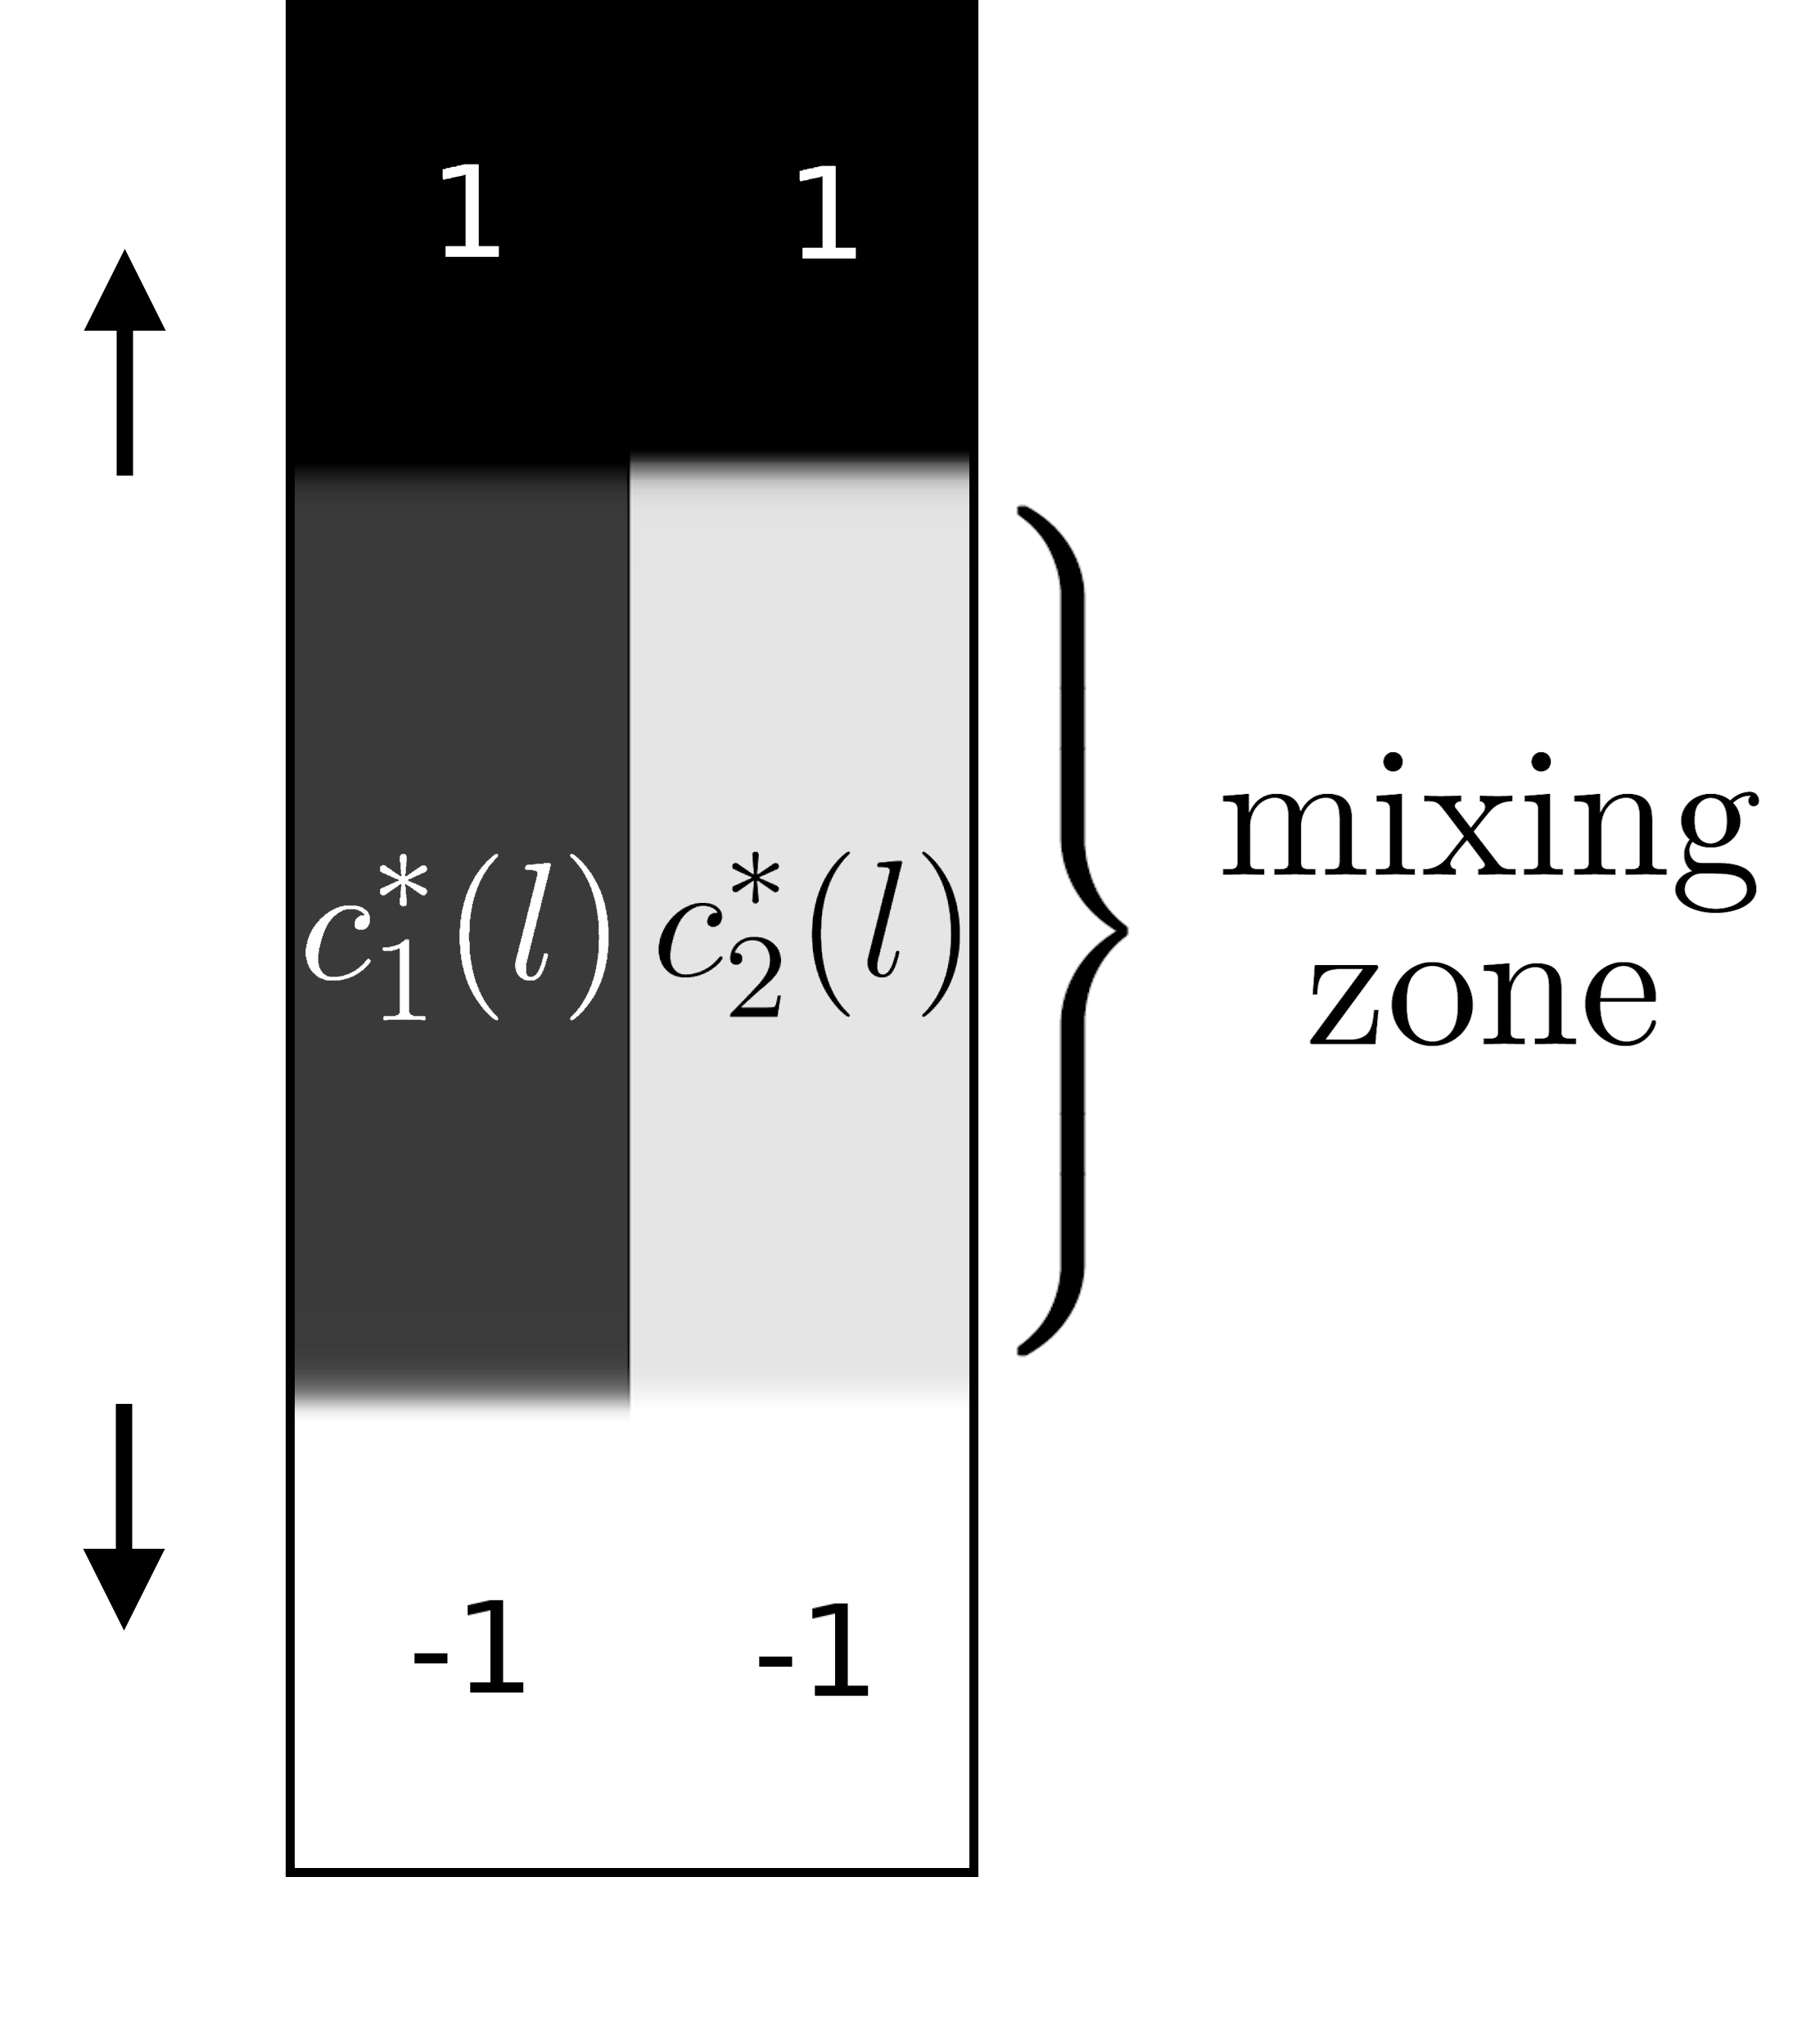
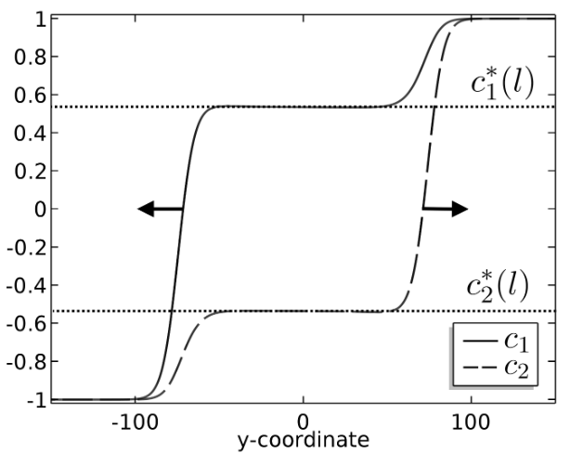
Outline
Introduction
Miscible displacement in porous media
viscous fingering
gravitational fingering
Problem statement
Two-tubes model
Main theorem
Proof:
traveling waves
slow-fast systems
geometric singular perturb. theory

Slide 3
Outline
Introduction
Miscible displacement in porous media
viscous fingering
gravitational fingering
Problem statement
Two-tubes model
Main theorem
Proof:
traveling waves
slow-fast systems
geometric singular perturb. theory

Slide 4
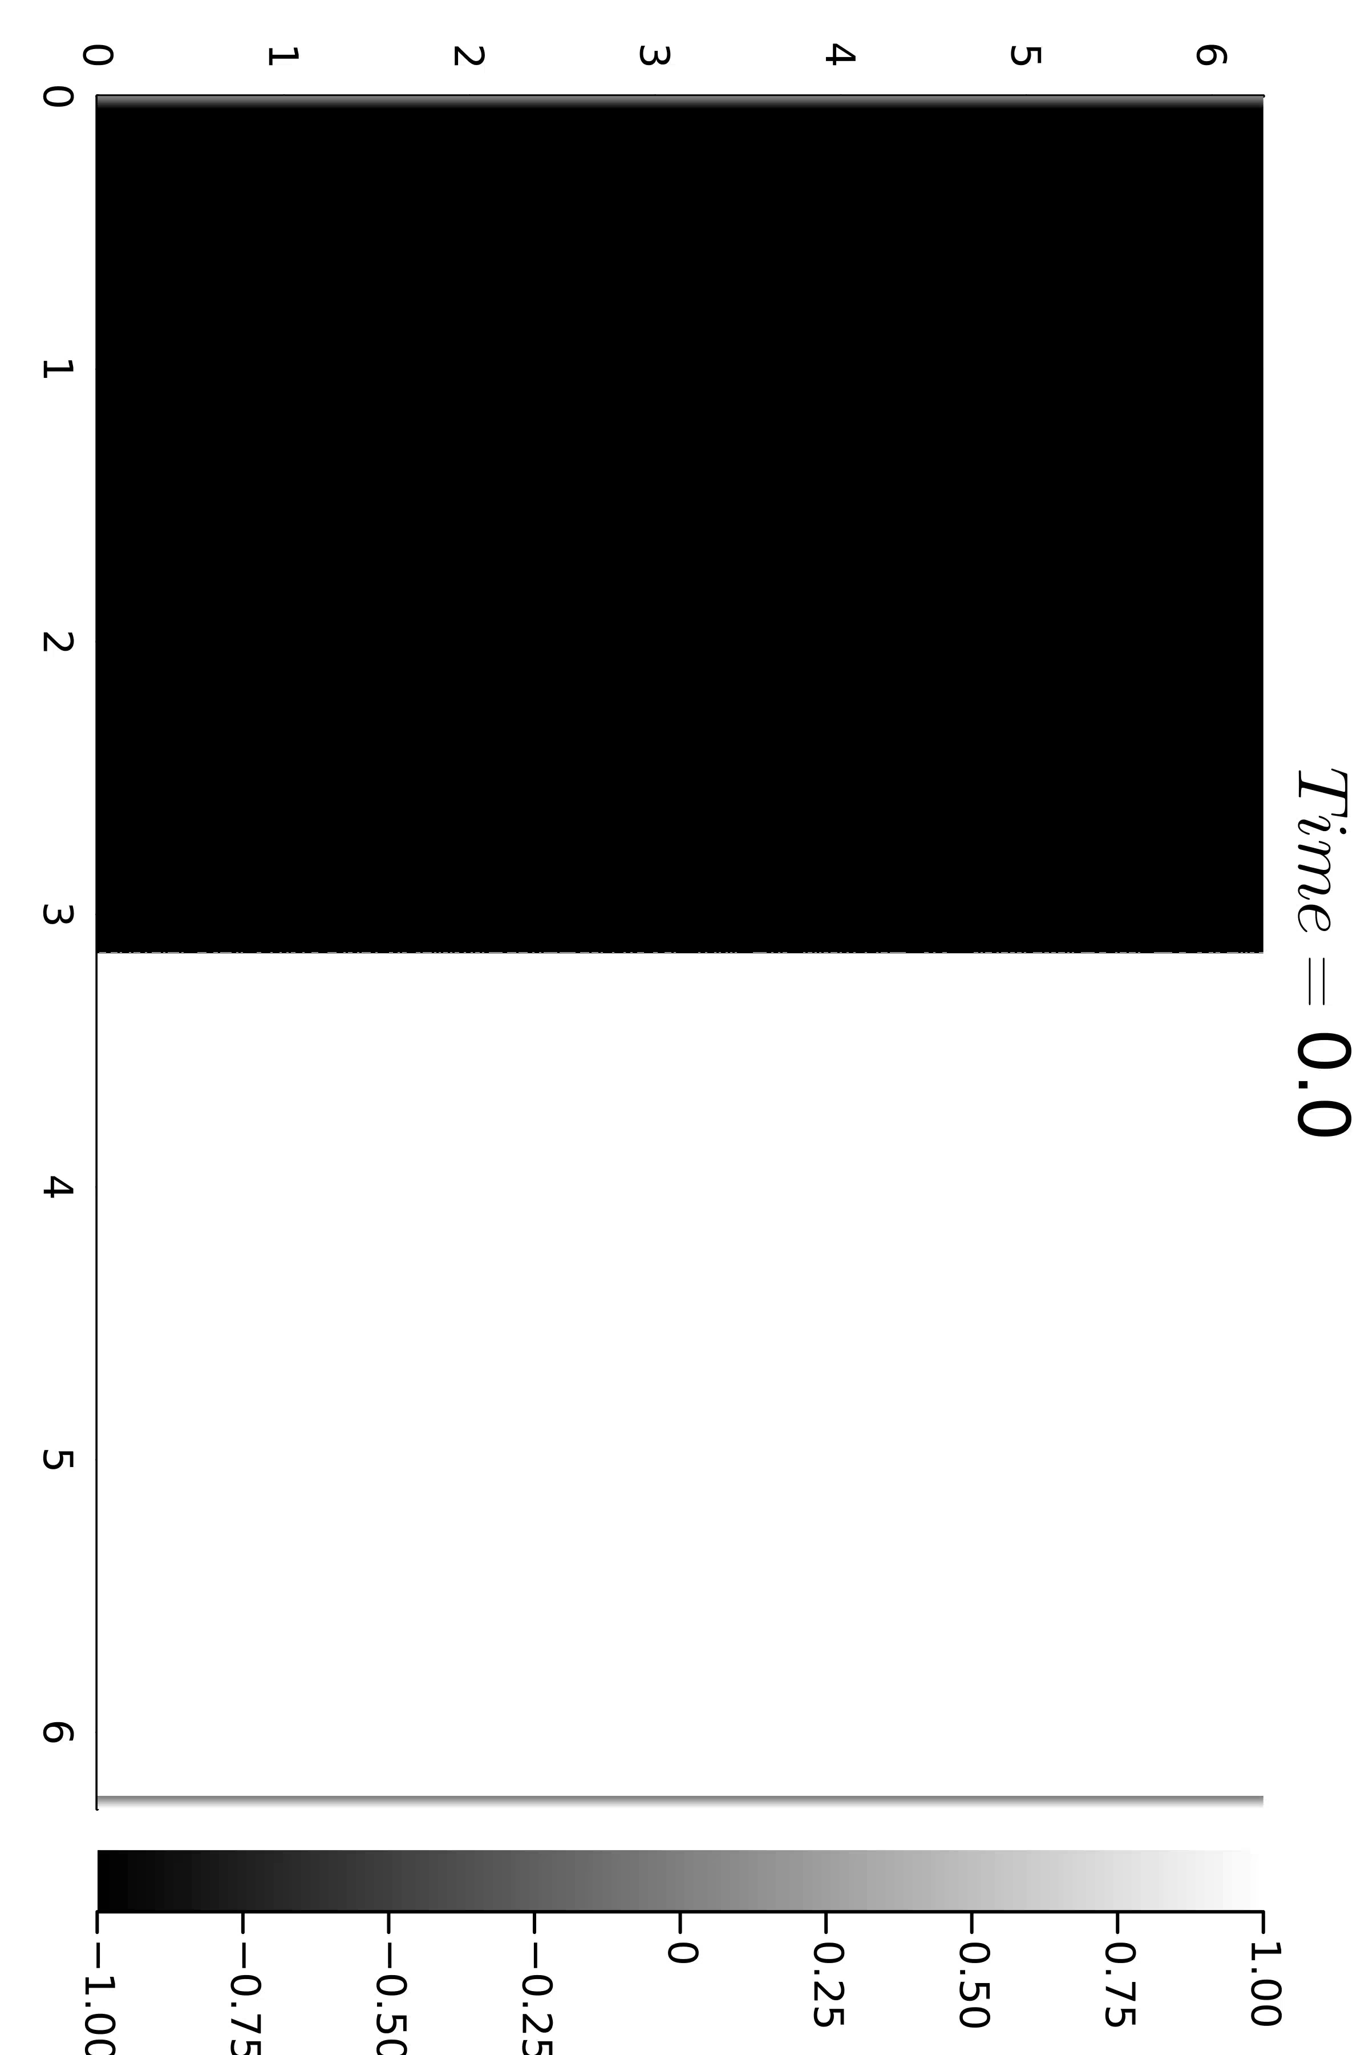
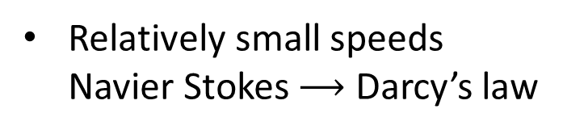
Gravitational fingering instability
Miscible displacement
porous media (averaged models of flow)
Heavy fluid
Relatively small speeds Navier Stokes $⟶$ Darcy’s law
Applications?
Light fluid
Credit: Nicolas Valade, INRIA
1

Slide 5

Viscous fingering phenomenon
water (blue color) polymerized water (red color)
Homsy , 1987 “Viscous Fingering in Porous Media”
Appears in applications: Enhanced Oil Recovery
Credit: Pavlov Dmitrii, St. Petersburg State University
2

Slide 6
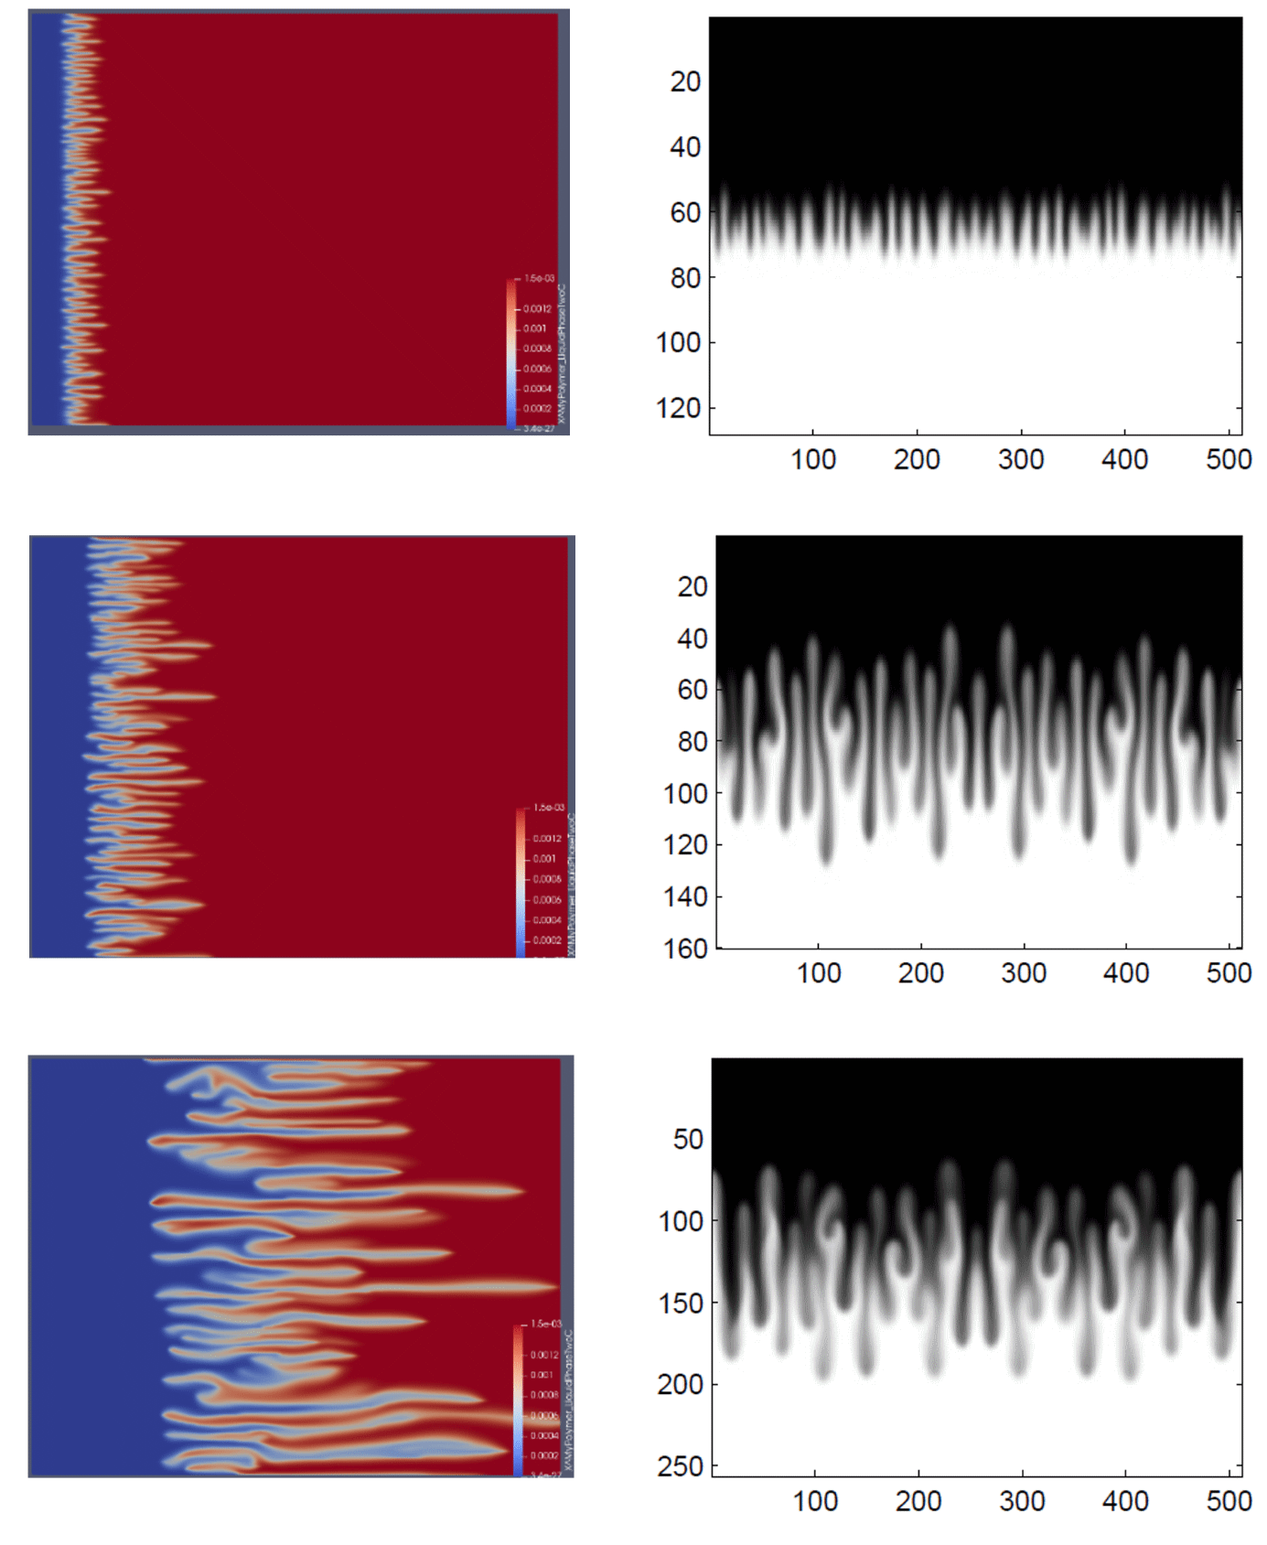
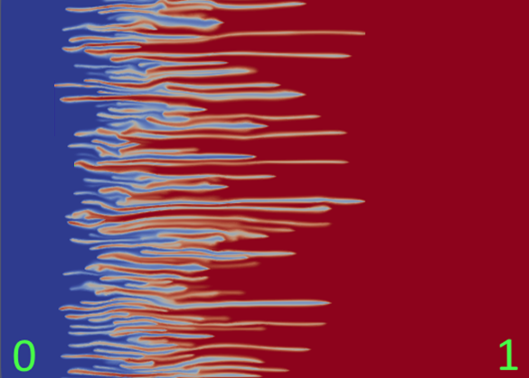
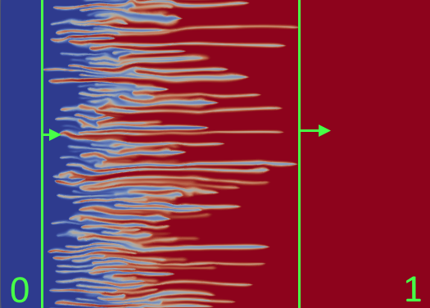
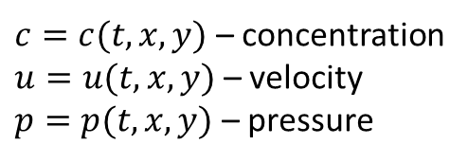
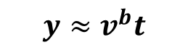
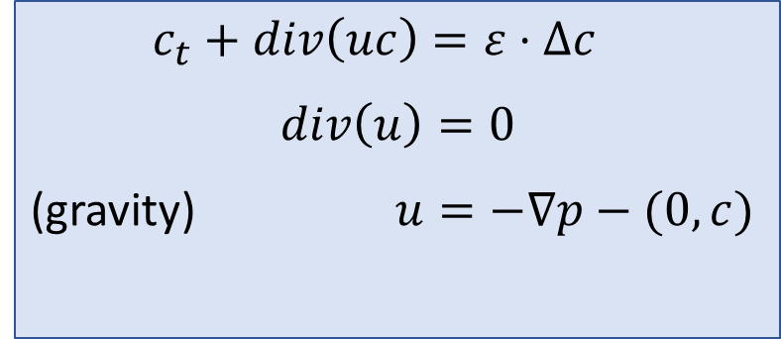

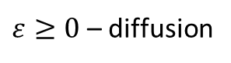


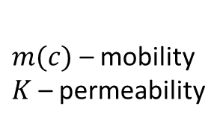
Incompressible Porous Medium eq – IPM, 2D (Two formulations)
Gravitational fingering
Viscous fingering
1
$$y≈v^{f}t$$
$c_{t}+div\left(uc\right)=ε⋅Δc$
$$div\left(u\right)=0$$
(gravity) $u=−∇p−(0,c)$
$$x≈v^{b}t$$
$$x≈v^{f}t$$
(viscosity) $u=−m\left(c\right) K ∇p$
-1
$$y≈v^{b}t$$
$c=c(t,x,y)$ – concentration
$u=u(t,x,y)$ – velocity
$p=p(t,x,y)$ – pressure
$ε≥0$ – diffusion
$m(c)$ – mobility
$K$ – permeability
mixing zone
many laboratory and numerical experiments show linear growth of the mixing zone
Question: how to find speeds $v^{b}$ and $v^{f}$ of propagation?
1969 – R. Wooding (JFM) Growth of fingers at an unstable diffusing interface in a porous medium or Hele-Shaw cell
…
2018 – J. Nijjer, D. Hewitt, J. Neufeld (JFM) The dynamics of miscible viscous fingering from onset to shutdown.
2022 – F. Bakharev, A. Enin, A. Groman, A. Kalyuzhnyuk, S. Matveenko, Y. Petrova, I. Starkov, S. Tikhomirov (JCAM)
3

Slide 7
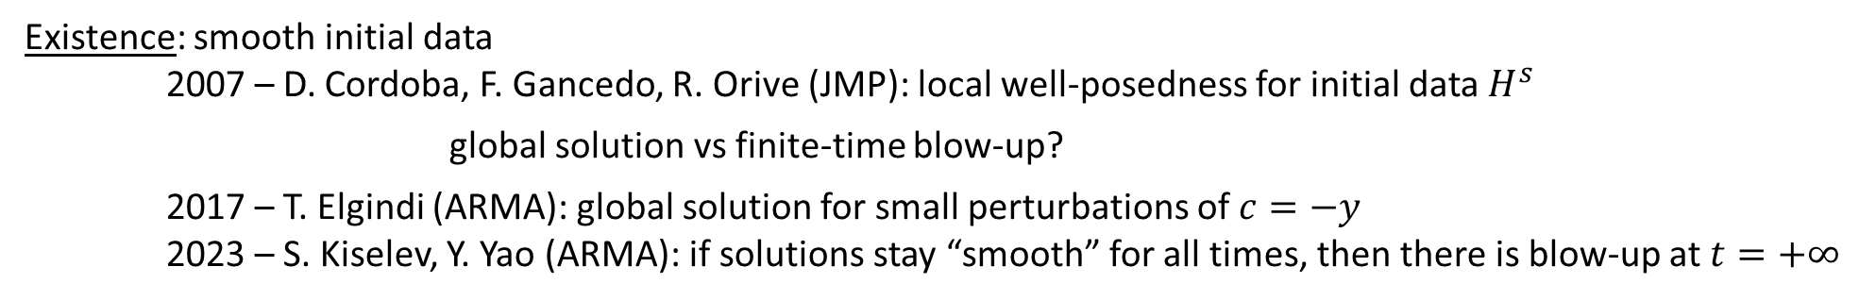
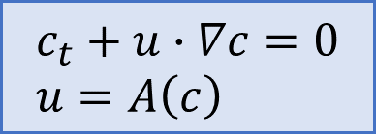
IPM: $ε=0 \text{(}\text{without} \text{diffusion}\text{)}$
$$c_{t}+u∙∇c=0 \\ u=A\left(c\right)$$
Active scalar:
$u=∇^{⊥}{\left(−Δ\right)}^{−1}∂_{1}c$ (Biot-Savart law)
Discontinuous initial data: free boundary problem (Muskat problem) – ill-posed for unstable stratification 2011 – A. Córdoba, D. Córdoba, F. Gancedo (Annals of Mathematics) “Interface evolution: the Hele-Shaw and Muskat problems”
Existence: smooth initial data
2007 – D. Cordoba, F. Gancedo, R. Orive (JMP): local well-posedness for initial data $H^{s}$ global solution vs finite-time blow-up?
2017 – T. Elgindi (ARMA): global solution for small perturbations of $c=−y$
2023 – S. Kiselev, Y. Yao (ARMA): if solutions stay “smooth” for all times, then there is blow-up at $t=+∞$
open
Uniqueness: non-uniqueness of weak solutions by convex integration
2011 – D. Córdoba, D. Faraco, F. Gancedo (ARMA)
2012 – L. Szekelyhidi Jr. (Annales de l'ENS)
Asymptotic stability of stable stratification:
2024 – R. Bianchini, T. Crin-Brat, M. Paicu (ARMA)
…and many others…
4

Slide 8
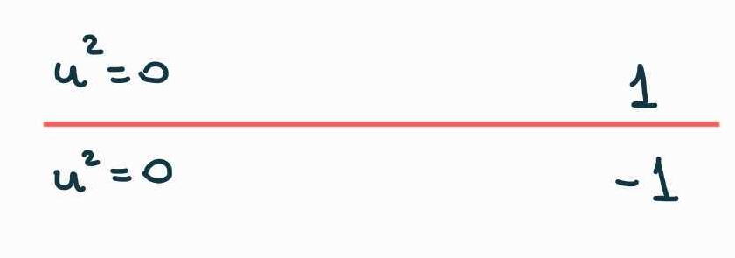
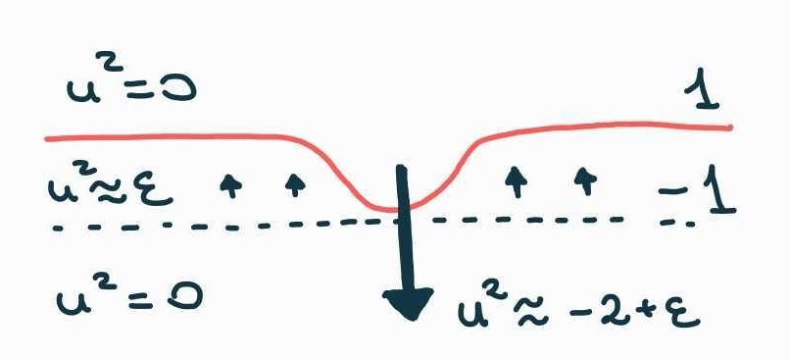
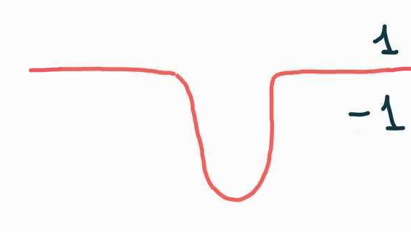
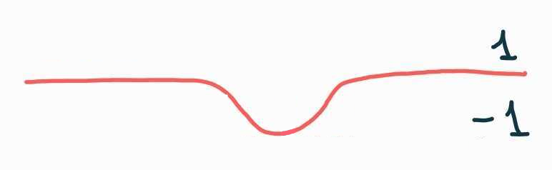
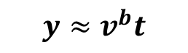
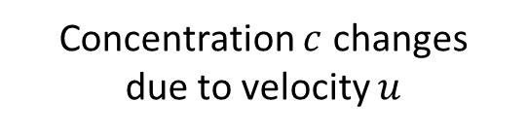
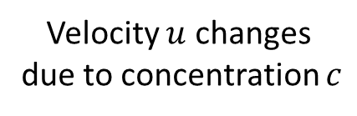
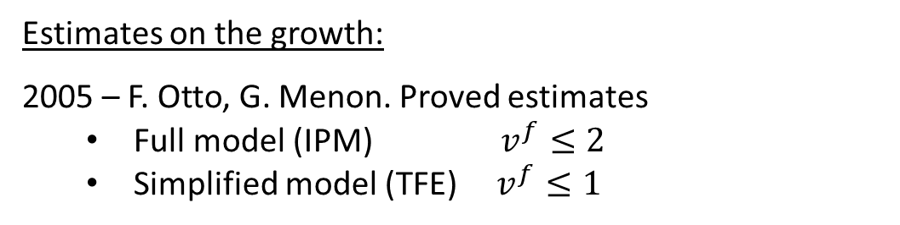

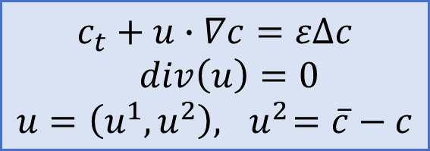
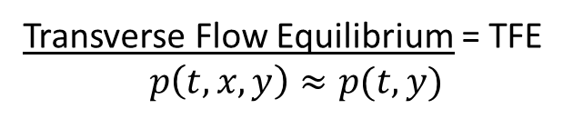
IPM: $ε>0$ (with diffusion)
Estimates on the growth:
2005 – F. Otto, G. Menon. Proved estimates
Full model (IPM) $v^{f}≤2$
Simplified model (TFE) $v^{f}≤1$
1
$$y≈v^{f}t$$
$$c_{t}+u∙∇c=εΔc$$
$div\left(u\right)=0$ $$u=\left(u^{1},u^{2}\right), { u}^{2}=\overline{c}−c$$
Transverse Flow Equilibrium = TFE $$p\left(t,x,y\right)≈p(t,y)$$
-1
$$y≈v^{b}t$$
Why fingers appear? It is a hair-trigger effect!
[2]
Velocity $u$ changes
due to concentration $c$
Concentration $c$ changes
due to velocity $u$
No flow
5

Slide 9
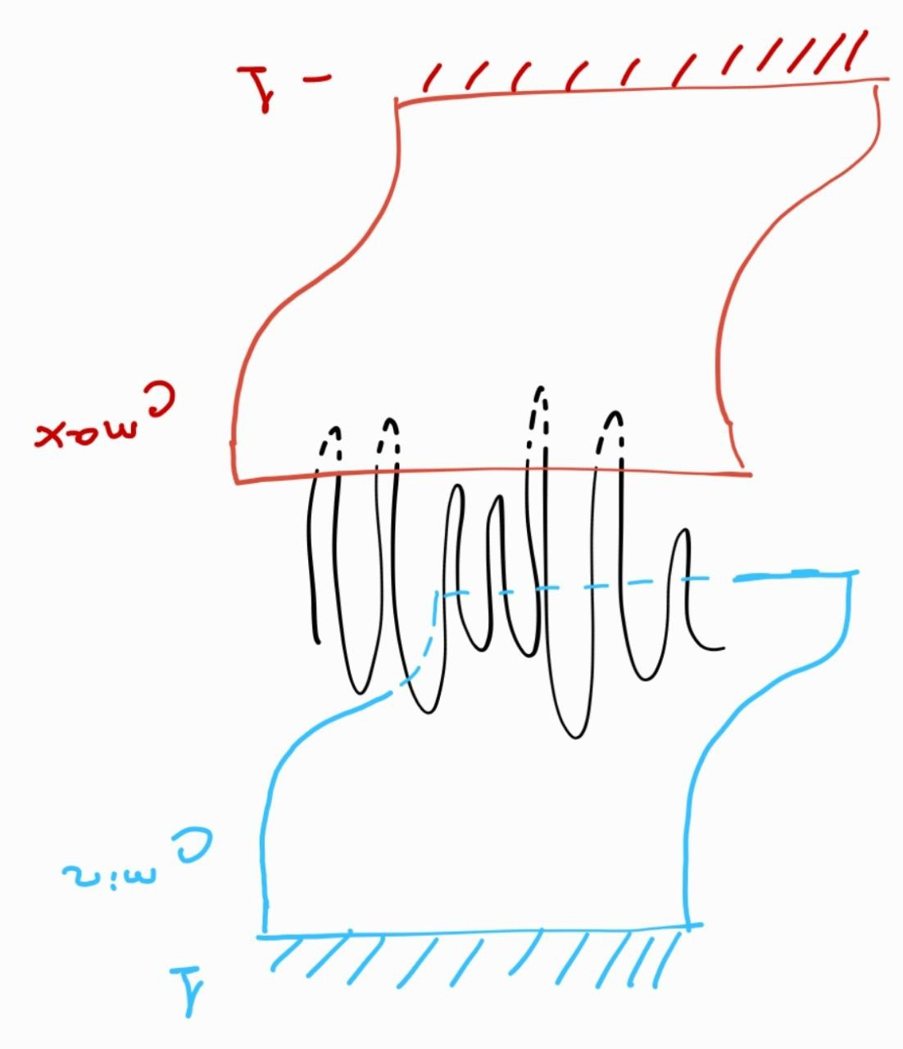
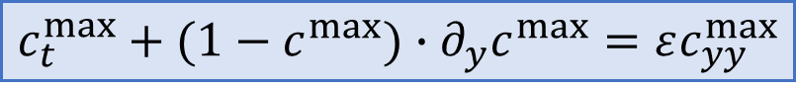
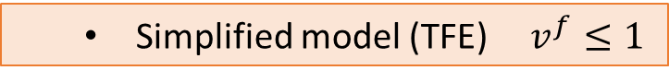
IPM: $ε>0$ (with diffusion)
Estimates on the growth:
2005 – F. Otto, G. Menon. Proved estimates
Full model (IPM) $v^{f}≤2$
Simplified model (TFE) $v^{f}≤1$
1
$$y≈v^{f}t$$
Simplified model (TFE) $v^{f}≤1$
$$c_{t}+u∙∇c=εΔc$$
$div\left(u\right)=0$ $$u=\left(u^{1},u^{2}\right), { u}^{2}=\overline{c}−c$$
Transverse Flow Equilibrium = TFE $$p\left(t,x,y\right)≈p(t,y)$$
-1
$$y≈v^{b}t$$
Idea of proof (TFE): comparison to 1D Burgers eq ($\overline{c}≤1$ then $u^{2}≤1−c$)
$$c_{t}^{max}+(1−c^{max})∙∂_{y}c^{max}=εc_{yy}^{max}$$
Theorem (Otto, Menon): If $c\left(0,x,y\right)≤c^{max}(0,y)$,
then $c\left(t,x,y\right)≤c^{max}(t,y)$ for any $t>0$.
Question: Are those estimates sharp?
5

Slide 10
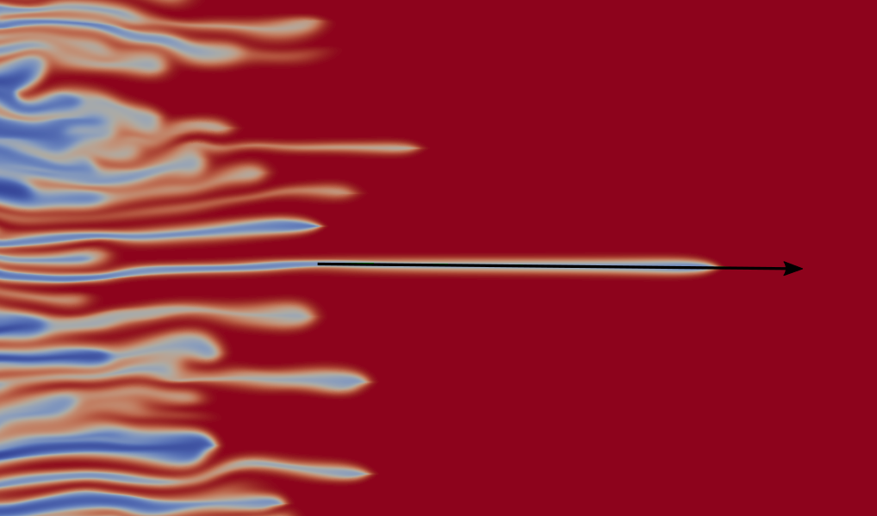
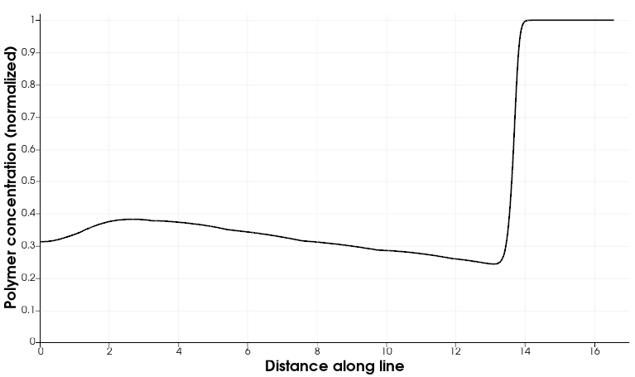
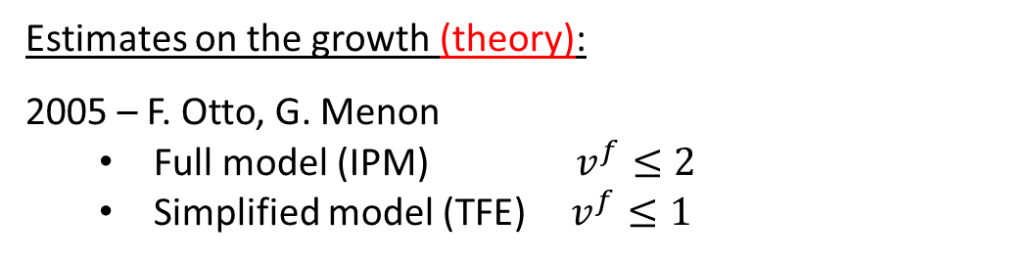
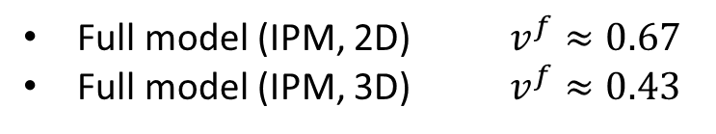
Are the estimates sharp?
Estimates on the growth (theory):
2005 – F. Otto, G. Menon
Full model (IPM) $v^{f}≤2$
Simplified model (TFE) $v^{f}≤1$
Estimates on the growth (numerics):
2022 – G. Bofetta, S. Musacchio
Full model (IPM, 2D) $v^{f}≈0.67$
Full model (IPM, 3D) $v^{f}≈0.43$
Viscous fingering: this gap in empirical and numerical estimates is even bigger
SLOW-DOWN of fingers… Why?
Two (possible) mechanisms:
Transport in transverse direction
Intermediate concentration on tip of finger
2024 – F. Bakharev, D. Pavlov, A. Enin, S. Matveenko, Yu. Petrova, N. Rastegaev, S. Tikhomirov (JCAM)
6

Slide 11
Outline
Introduction
Miscible displacement in porous media
viscous fingering
gravitational fingering
Problem statement
Two-tubes model
Main theorem
Proof:
traveling waves
slow-fast systems
geometric singular perturb. theory

Slide 12
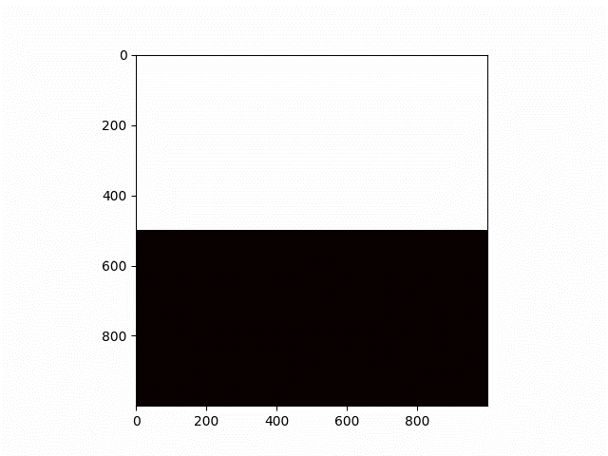
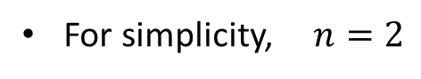
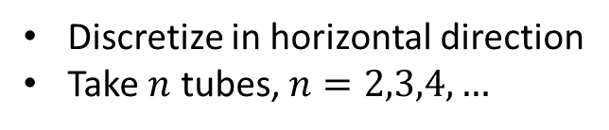
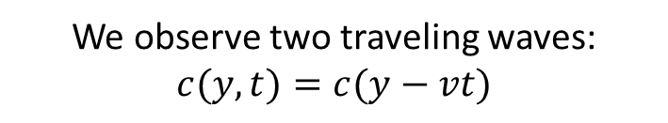
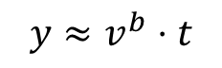
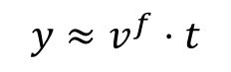
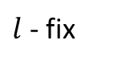

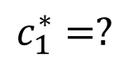
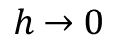
IDEA: semi-discrete model of gravitational fingering
Discretize in horizontal direction
Take $n$ tubes, $n=2,3,4,…$
Limit of
numerical scheme
For simplicity, $n=2$
1
1
$$y≈v^{f}⋅t$$
$$h→0$$
$$c_{1}^{∗}=?$$
$$c_{2}^{∗}=?$$
$$y≈v^{b}⋅t$$
-1
-1
$l$ - fix
Finite volume
Upwind
We observe two traveling waves: $c(y,t)=c(y−vt)$
Tubes (layer, lane,…) models:
1995 — Y. Yortsos “A theoretical analysis of vertical flow equilibrium” 2006 — J.C. Da Mota, S. Schecter “Combustion fronts in a porous medium with two layers”
2019 — A. Armiti-Juber, C. Rohde “On Darcy- and Brinkman-type models for two-phase flow in asympt. flat domains”
2019 — H. Holden, N. Risebro “Models for dense multilane vehicular traffic”
7

Slide 13
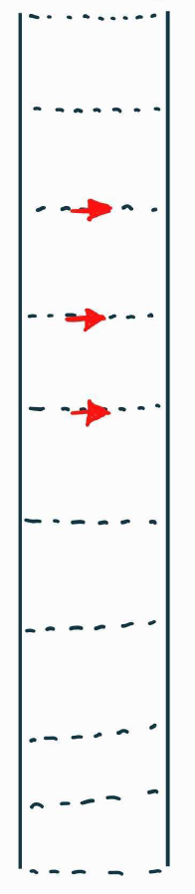
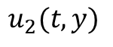
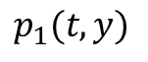
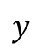

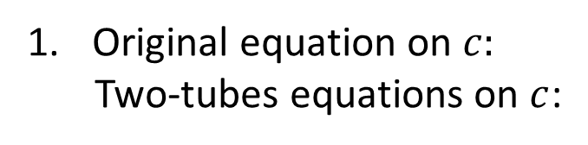
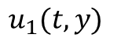
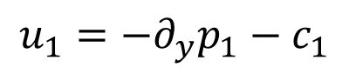
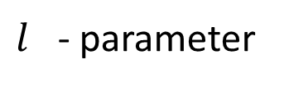














Two-tubes model
Original equation on $c:$
Two-tubes equations on $c$:
$$y$$
$$c_{t}+div\left(uc\right)− ∆c=0$$
$$c_{1}(t,y)$$
$$c_{2}(t,y)$$
$$B$$
$$∂_{t}c_{1}+∂_{y}\left(u_{1}c_{1}\right)−∂_{yy}c_{1}=−B$$
$$∂_{t}c_{2}+∂_{y}\left(u_{2}c_{2}\right)−∂_{yy}c_{2}=+B$$
$$u_{1}(t,y)$$
$$u_{T}(t,y)$$
$$u_{2}(t,y)$$
Original equation on $p:$
Two-tubes equations on $p$:
$$u=−∇p −(0,c)$$
$$p_{1}(t,y)$$
$$p_{2}(t,y)$$
$$u_{1}=−∂_{y}p_{1}−c_{1}$$
$$u_{2}=−∂_{y}p_{2}−c_{2}$$
$l$ - parameter
$$u_{T}=−\frac{p_{2}−p_{1}}{l}$$
$$B=\left\{\left.\begin{aligned}\frac{u_{T}}{l}⋅c_{1}, u_{T}>0, \\ \frac{u_{T}}{l}⋅c_{2}, u_{T}<0\end{aligned}\right.\right.$$
Original equation on $u$:
Two-tubes equations on $u$:
$$div(u)=0$$
$$∂_{y}u_{1}+\frac{u_{T}}{l}=0$$
8

Slide 14







Two-tubes model
Original equation on $c:$
Two-tubes equations on $c$:
$$y$$
$$c_{t}+div\left(uc\right)− ∆c=0$$
$$c_{1}(t,y)$$
$$c_{2}(t,y)$$
$$B$$
$$∂_{t}c_{1}+∂_{y}\left(u_{1}c_{1}\right)−∂_{yy}c_{1}=−B$$
$$∂_{t}c_{2}+∂_{y}\left(u_{2}c_{2}\right)−∂_{yy}c_{2}=+B$$
$$u_{1}(t,y)$$
$$u_{T}(t,y)$$
$$u_{2}(t,y)$$
Original equation on $p:$
Two-tubes equations on $p$:
$$u=−∇p −(0,c)$$
$$p_{1}(t,y)$$
$$p_{2}(t,y)$$
$$u_{1}=−∂_{y}p_{1}−c_{1}$$
$$u_{2}=−∂_{y}p_{2}−c_{2}$$
$l$ - parameter
$$\boxed{\frac{u_{T}}{l}}$$
$$=−\frac{p_{2}−p_{1}}{l^{2}}$$
$$\boxed{\frac{u_{T}}{l}}$$
$$B=\left\{\left.\begin{aligned} \frac{u_{T}}{l} ⋅c_{1}, u_{T}>0, \\ \frac{u_{T}}{l} ⋅c_{2}, u_{T}<0\end{aligned}\right.\right.$$
Original equation on $u$:
Two-tubes equations on $u$:
$$div(u)=0$$
$$\boxed{\frac{u_{T}}{l}}$$
$$\boxed{\frac{u_{T}}{l}}$$
$$∂_{y}u_{1}+ =0$$
8

Slide 15






















Main result
The proof is valid only for $l>0$ sufficiently small
Numerics suggests the same statement for $∀l>0$
Moreover, $\lim_{l→0}{c_{1}^{∗}(l)}=−\frac{1}{2}, \lim_{l→0}{c_{2}^{∗}(l)}=\frac{1}{2}$, $\lim_{l→0}{v^{b}(l)}=−\frac{1}{4}, \lim_{l→0}{v^{f}(l)}=\frac{1}{4}.$
Questions?
$$∂_{t}c_{1}+∂_{y}\left(u_{1}c_{1}\right)− ∂_{yy}c_{1}=−B$$
$$∂_{t}c_{2}+∂_{y}\left(u_{2}c_{2}\right)− ∂_{yy}c_{2}= B$$
$$B=\left\{\left.\begin{aligned}−∂_{y}u_{1}⋅c_{1}, ∂_{y}u_{1}<0, \\ +∂_{y}u_{2}⋅c_{2}, ∂_{y}u_{1}>0\end{aligned}\right.\right.$$
($∗$)
$$u_{1}=−∂_{y}p_{1}−c_{1}$$
$$u_{2}=−∂_{y}p_{2}−c_{2}$$
$y→+∞: c_{1,2}→+1$; $u_{1,2,T}→0$
$y→−∞:$ $c_{1,2}→−1;$ $u_{1,2,T}→0$
$$∂_{y}u_{1}=−∂_{y}u_{2}=\frac{p_{2}−p_{1}}{l^{2}}$$
Theorem (P., Tikhomirov, Efendiev, arXiv: 2401.05981, accept. SIMA)
Consider a two-tube model with gravity $(∗)$.
As $t→∞$ we observe:
$c_{1,2}\left(t,+∞\right)=+1$; $c_{1,2}\left(t,−∞\right)=−1$
$u_{1,2}\left(t,+∞\right)=0$
$\left(p_{2}−p_{1}\right)\left(t,±∞\right)\sim u_{T}\left(t,±∞\right)=0$
$$1$$
there exists $c_{1}^{∗}(l), c_{2}^{∗}(l)$
Then for all $l>0$ sufficiently small
$$c_{2}^{∗}(l)$$
such that there exist two traveling waves (TW):
$c_{1}$ - blue
$c_{2}$ - green
TW1 with speed $v^{b}(l)$: $\left(−1, −1\right) → \left(c_{1}^{∗},(l) c_{2}^{∗}(l)\right)$ TW2 with speed $v^{f}\left(l\right)$: $\left(c_{1}^{∗},(l) c_{2}^{∗}(l)\right) → \left(1, 1\right).$
$$c_{1}^{∗}(l)$$
$$−1$$
Moreover, $\lim_{l→0}{c_{1}^{∗}\left(l\right)=−\lim_{l→0}{c_{2}^{∗}\left(l\right)}=−\frac{1}{2}}; \lim_{l→0}{v^{f}\left(l\right)}=−\lim_{l→0}{v^{b}\left(l\right)}=\frac{1}{4}.$
9

Slide 16





Many tubes: numerics
The proof is valid only for $l>0$ sufficiently small
Numerics suggests the same statement for $∀l>0$
Moreover, $\lim_{l→0}{c_{1}^{∗}(l)}=−\frac{1}{2}, \lim_{l→0}{c_{2}^{∗}(l)}=\frac{1}{2}$, $\lim_{l→0}{v^{b}(l)}=−\frac{1}{4}, \lim_{l→0}{v^{f}(l)}=\frac{1}{4}.$
3 tubes
4 tubes
7 tubes
Questions:
(open)
(1) explain the structure of “asymptotic solutions” for $n$ tubes and study their stability
(2) find speed of growth of the mixing zone
(3) understand the behaviour as $n→∞$. Do we approximate 2-dim IPM?
(4) can we repeat this story for the many tubes viscous fingering model?
10

Slide 17















Well-posedness for two-tubes model?
$t≥0$ $y∈ℝ$
Two-tubes IPM
Two-tubes TFE
$$∂_{t}c_{1}+∂_{y}\left(u_{1}c_{1}\right)− ∂_{yy}c_{1}=−B$$
$$∂_{t}c_{2}+∂_{y}\left(u_{2}c_{2}\right)− ∂_{yy}c_{2}= B$$
$$∂_{t}c_{1}+∂_{y}\left(u_{1}c_{1}\right)− ∂_{yy}c_{1}=−B$$
$$∂_{t}c_{2}+∂_{y}\left(u_{2}c_{2}\right)− ∂_{yy}c_{2}= B$$
$$l→0?$$
$$u_{1}=−∂_{y}p_{1}−c_{1}$$
$$u_{1}=\frac{c_{2}+c_{1}}{2}−c_{1}=\overline{c}−c_{1}$$
$$u_{2}=−∂_{y}p_{2}−c_{2}$$
$$B=\left\{\left.\begin{aligned}−∂_{y}u_{1}⋅c_{1}, ∂_{y}u_{1}<0, \\ +∂_{y}u_{2}⋅c_{2}, ∂_{y}u_{1}>0\end{aligned}\right.\right.$$
$$B=\left\{\left.\begin{aligned}−∂_{y}u_{1}⋅c_{1}, ∂_{y}u_{1}<0, \\ +∂_{y}u_{2}⋅c_{2}, ∂_{y}u_{1}>0\end{aligned}\right.\right.$$
$$∂_{y}u_{1}=−∂_{y}u_{2}=\frac{p_{2}−p_{1}}{l^{2}}$$
$l=0:$ singular limit
Initial Condition: $$c_{1}\left(0,y\right)=c_{1}^{0}\left(y\right)$$
$$c_{2}\left(0,y\right)=c_{2}^{0}\left(y\right)$$
Conditions at $y=$ $±∞$:
$$c_{1,2}\left(t,+∞\right)=+1$$
$$c_{1,2}\left(t,−∞\right)=−1$$
$u_{1,2}\left(t,±∞\right)=0$
$$\left(p_{2}−p_{1}\right)\left(t,±∞\right)=0$$
Questions
(open):
Does there exist global solution $\left(c_{1},c_{2},u_{1},u_{2},p_{1},p_{2}\right)∈C\left(\left[0,∞\right];X\right)$ for suitable Banach space $X$?
As $t→∞$ does solution converge to a propagating terrace (combination of two traveling waves)?
11
Can we rigorously justify the singular limit as $l→0$?

Slide 18
Outline
Introduction
Miscible displacement in porous media
viscous fingering
gravitational fingering
Problem statement
Two-tubes model
Main theorem
Proof:
traveling waves
slow-fast systems
geometric singular perturb. theory

Slide 19
Main result
The proof is valid only for $l>0$ sufficiently small
Numerics suggests the same statement for $∀l>0$
Moreover, $\lim_{l→0}{c_{1}^{∗}(l)}=−\frac{1}{2}, \lim_{l→0}{c_{2}^{∗}(l)}=\frac{1}{2}$, $\lim_{l→0}{v^{b}(l)}=−\frac{1}{4}, \lim_{l→0}{v^{f}(l)}=\frac{1}{4}.$
Questions?
$$∂_{t}c_{1}+∂_{y}\left(u_{1}c_{1}\right)− ∂_{yy}c_{1}=−B$$
$$∂_{t}c_{2}+∂_{y}\left(u_{2}c_{2}\right)− ∂_{yy}c_{2}= B$$
$$B=\left\{\left.\begin{aligned}−∂_{y}u_{1}⋅c_{1}, ∂_{y}u_{1}<0, \\ +∂_{y}u_{2}⋅c_{2}, ∂_{y}u_{1}>0\end{aligned}\right.\right.$$
($∗$)
$$u_{1}=−∂_{y}p_{1}−c_{1}$$
$$u_{2}=−∂_{y}p_{2}−c_{2}$$
$y→+∞: c_{1,2}→+1$; $u_{1,2,T}→0$
$y→−∞:$ $c_{1,2}→−1;$ $u_{1,2,T}→0$
$$∂_{y}u_{1}=−∂_{y}u_{2}=\frac{p_{2}−p_{1}}{l^{2}}$$
Theorem (P., Tikhomirov, Efendiev, arXiv: 2401.05981, accept. SIMA)
Consider a two-tube model with gravity $(∗)$.
As $t→∞$ we observe:
$c_{1,2}\left(t,+∞\right)=+1$; $c_{1,2}\left(t,−∞\right)=−1$
$u_{1,2}\left(t,+∞\right)=0$
$\left(p_{2}−p_{1}\right)\left(t,±∞\right)\sim u_{T}\left(t,±∞\right)=0$
$$1$$
there exists $c_{1}^{∗}(l), c_{2}^{∗}(l)$
Then for all $l>0$ sufficiently small
$$c_{2}^{∗}(l)$$
such that there exist two traveling waves (TW):
$c_{1}$ - blue
$c_{2}$ - green
TW1 with speed $v^{b}(l)$: $\left(−1, −1\right) → \left(c_{1}^{∗},(l) c_{2}^{∗}(l)\right)$ TW2 with speed $v^{f}\left(l\right)$: $\left(c_{1}^{∗},(l) c_{2}^{∗}(l)\right) → \left(1, 1\right).$
$$c_{1}^{∗}(l)$$
$$−1$$
Moreover, $\lim_{l→0}{c_{1}^{∗}\left(l\right)=−\lim_{l→0}{c_{2}^{∗}\left(l\right)}=−\frac{1}{2}}; \lim_{l→0}{v^{f}\left(l\right)}=−\lim_{l→0}{v^{b}\left(l\right)}=\frac{1}{4}.$
9

Slide 20






Scheme of proof
Travelling wave (TW) ansatz with fixed $v$:
Step 1: structure of the set of traveling wave (TW) solutions
$$c_{1}\left(t,y\right)=c_{1}\left(y−vt\right)$$
$$c_{2}\left(t,y\right)=c_{2}\left(y−vt\right)$$
$$u_{1}\left(t,y\right)=u_{1}\left(y−vt\right)$$
$$u_{2}\left(t,y\right)=u_{2}\left(y−vt\right)$$
$$p_{1}\left(t,y\right)=p_{1}\left(y−vt\right)$$
$$p_{2}\left(t,y\right)=p_{2}(y−ct)$$
Theorem
For sufficiently small $l>0$ and for each $v$close to $\frac{1}{4}$ there exists a TW: $$\left(c_{1}^{∗}, c_{2}^{∗},u_{1}^{∗}, u_{2}^{∗},p_{1}^{∗}−p_{2}^{∗}\right)→(1,1,0,0,0)$$
$$\dot{Z}=H_{v,l}(Z)$$
Similarly,
$$\left(−1,−1,0,0,0\right)→\left(c_{1}^{∗∗}, c_{2}^{∗∗},u_{1}^{∗∗}, u_{2}^{∗∗},p_{1}^{∗∗}−p_{2}^{∗∗}\right)$$
Step 2: existence of a propagating terrace of two traveling waves
Find a common intermediate state $(c_{1},c_{2},u_{1},u_{2},p_{1}−p_{2})$ for traveling waves above
12

Slide 21










Scheme of proof: step 1
СПАСИБО за внимание! Приезжайте в гости в Рио-де-Жанейро!
System of ODEs in $ℝ^{6}$:
Travelling wave (TW) ansatz with fixed $v$:
$$c_{1}\left(t,y\right)=c_{1}\left(y−vt\right)$$
$$c_{2}\left(t,y\right)=c_{2}\left(y−vt\right)$$
$$u_{1}\left(t,y\right)=u_{1}\left(y−vt\right)$$
$$u_{2}\left(t,y\right)=u_{2} \left(y−vt\right)$$
$$p_{1}\left(t,y\right)=p_{1}\left(y−vt\right)$$
$$p_{2}\left(t,y\right)=p_{2}(y−ct)$$
$$\left\{\begin{aligned} \dot{X}=F_{v}(X,Y) \\ l⋅\dot{Y}=AY−BX\end{aligned}\right.$$
Here:
$X=\left(\begin{aligned}\begin{aligned}c_{1} \\ c_{2} \\ ∂_{ξ}c_{1}\end{aligned} \\ ∂_{ξ}c_{2}\end{aligned}\right)∈ℝ^{4}$, $Y=\left({u_{1} \atop p_{1}−p_{2}}\right)∈ℝ^{2}$
$A=\left(\begin{matrix}0 & 1 \\ 2 & 0\end{matrix}\right)$, $B∈M^{2×4}$, $l≪1$
With condition at $+∞:$
$$c_{1}\left(+∞\right)=1$$
$$c_{2}\left(+∞\right)=1$$
$$u_{1}\left(+∞\right)=0$$
$$u_{2}\left(+∞\right)=0$$
$$\left(p_{1}−p_{2}\right)\left(+∞\right)=0$$
Obs: for $l→0$this system has a ``slow-fast’’ structure
Key tool: geometric singular perturbation theory (GSPT)
1979 – N. Fenichel (JDE); 2020 – M. Wechselberger
Aim: $∀v$ $∃$TW
find a heteroclinic orbit $\left(X\left(ξ\right),Y\left(ξ\right)\right), ξ∈ℝ$ such that $\left(X\left(+∞\right), Y\left(+∞\right)\right)=$ given point.
13

Slide 22








Scheme of proof: step 2 – propagating terrace of 2 TW
1) For each $v^{f}∈I_{f}⊂ℝ$ we find all points s.t. there exists a TW:
$$\left(c_{1} ,c_{2}\right) → \left(1, 1\right)$$
2) For each $v^{b}∈I_{b}⊂ℝ$ we find all points s.t. there exists a TW:
$$\left(−1, −1\right)→\left(c_{1} ,c_{2}\right)$$
3) Find the intersection points of these two curves
$l=0$ – these curves are just straight lines
$0<l≪1$– perturbation argument
14

Slide 23















Slow-fast systems: simple example
Slow system
Fast system
$$t=ε⋅s$$
$$\left\{\begin{aligned} \dot{x} =−x \\ ε⋅\dot{y } =x^{2}−y\end{aligned}\right.$$
$$\left\{\begin{aligned}x^{′} =ε⋅\left(−x\right) \\ { y}^{′} = x^{2}−y \end{aligned}\right.$$
$$0<ε≪1$$
$$ε=1.0$$
$$ε=0.1$$
$$ε=0.5$$
$$ε=1.5$$
Formally
$$ε→0$$
Formally
$$ε→0$$
Reduced slow system
Reduced fast system
$$\left\{\begin{aligned}\dot{x} = −x \\ 0 = x^{2}−y\end{aligned}\right.$$
$x$ – slow variable
$y$ – fast variable
$S=\left\{x^{2}−y=0\right\}$
$S$ - critical set
$$\left\{\begin{aligned}x^{′} = 0 \\ { y}^{′} = x^{2}−y\end{aligned}\right.$$
15

Slide 24










Geometric singular perturbation theory (GSPT)
Slow system ($t$ – slow time)
Fast system ($s$ – fast time)
$$\left\{\begin{aligned} \dot{X} = F (X,Y,ε) \\ ε⋅\dot{Y } = G(X,Y,ε)\end{aligned}\right.$$
$$t=ε⋅s$$
$$\left\{\begin{aligned}X^{′} = ε⋅F \left(X,Y,ε\right) \\ { Y}^{′} = G\left(X,Y,ε\right) \end{aligned}\right.$$
$$0<ε≪1$$
Formally
$$ε→0$$
Formally
$$ε→0$$
Reduced slow system
Reduced fast system
$$\left\{\begin{aligned} \dot{X} = F \left(X,Y,0\right) \\ 0 = G(X,Y,0)\end{aligned}\right.$$
$$\left\{\begin{aligned}X^{′} = 0 \\ { Y}^{′} = G\left(X,Y,0\right)\end{aligned}\right.$$
$S=\{G\left(X,Y,0\right)=0\}$ – critical set
empty or consists of isolated points
contains a differentiable manifold
(regular perturbation problem)
(singular perturbation problem)
16

Slide 25



Normally hyperbolic manifolds (“fast-slow” version)
$$\left\{\begin{aligned}X^{′} = ε⋅F \left(X,Y,ε\right) \\ { Y}^{′} = G\left(X,Y,ε\right) \end{aligned}\right.$$
$\left(X,Y\right)∈ℝ^{m}×ℝ^{n}$, $F(X,Y,ε)$, $G(X,Y,ε)$ – smooth
$S=\{\left(X,Y\right)∈ℝ^{m+n}: G\left(X,Y,0\right)=0\}$ – critical manifold
Definition: A smooth compact manifold $S_{0}⊂S$ is called normally hyperbolic if
the $n×n$ matrix $DG_{Y}(X,Y,0)$ is hyperbolic for all $\left(X,Y\right)∈S_{0}$.
In particular, $S_{0}$ is called:
- attracting, if all eigenvalues of $DG_{y}(X,Y,0)$ have negative real part
- repelling, if all eigenvalues of $DG_{y}(X,Y,0)$ have positive real part
- of saddle-type, if it is neither attracting nor repelling
Normal hyperbolicity of critical manifold $⇒$ ``nice’’ perturbation
1979 – N. Fenichel (JDE) Geometric singular perturbation theory for ordinary differential equations
2015 – C. Kuehn, Multiple Time Scale Dynamics (Chapters 1-3) – intro to slow-fast systems & Fenichel’s work
17

Slide 26




Fenichel’s theorem (``fast-slow’’ version)
Let $S_{0}$ be a compact normally hyperbolic submanifold (possibly with boundary) of the critical manifold $S$ of the system
and that $F,G∈ C^{r} (r≥2)$.
$$\left\{\begin{aligned}X^{′} = ε⋅F \left(X,Y,ε\right) \\ { Y}^{′} = G\left(X,Y,ε\right) \end{aligned}\right.$$
Then for $ε>0$ sufficiently small, the following hold:
(F1) There exists a locally invariant manifold $S_{ε}$ diffeomorphic to $S_{0}$.
(F2) $S_{ε}$ has Hausdorff distance $O(ε)$ from $S_{0}$ (as $ε → 0$).
(F3) The flow on $S_{ε}$ converges to the flow of the reduced slow system$\left(\text{a}\text{s} ε → 0\right).$
(F4) $S_{ε}$ is $C^{r}$-smooth and normally hyperbolic
Remark: $S_{ε}$ may be not unique
Local invariance means that trajectories can enter or leave $S_{ε}$ only through its boundaries.
18

Slide 27





Scheme of proof: step 1 (more detailed)
$$\left\{\begin{aligned} \dot{X}=F_{v}(X,Y) \\ l⋅\dot{Y}=AY−BX\end{aligned}\right.$$
Critical manifold: $S=\left\{\left(X,Y\right): Y=A^{−1}BX\right\}, \dim{S}=4$
$K⊂S$ (compact) is normally hyperbolic as the matrix $A=\left(\begin{matrix}0 & 1 \\ 2 & 0\end{matrix}\right)$ has eigenvalues $λ_{±}=±\sqrt{2}$
$X∈ℝ^{4}$ - slow
$Y∈ℝ^{2}$ - fast
$l≪1$
Thus, by Fenichel’s theorem for $l$ $≪1$
For any compact submanifold $K⊂S$ there exists a locally invariant manifold $K_{l}⊂ℝ^{6}$
$K_{l}=\{\left(X,Y\right): Y=A^{−1}BX+l⋅h(X,l)\}$ for some smooth function $h$
6-dim
Result: system on $\left(X,Y\right)$ $⇒$ system on $X$on $K_{l}$:
4-dim
$$\dot{X}=F_{v}(X, A^{−1}BX+l⋅h(X,l))$$
19

Slide 28









Scheme of proof: step 1 (more detailed)
THE END
We have a perturbation problem ($X∈ℝ^{4}$):
$l>0$:
$$\dot{X}=F_{v}(X, A^{−1}BX+l⋅h(X,l))$$
$l=0$:
$$\dot{X}=F_{v}\left(X,A^{−1}BX\right)$$
$$\left\{\begin{aligned}\dot{a}=r \\ \dot{b}=s \\ \dot{r}=−vr−\frac{a}{2}(s−r) \\ \dot{s}=−vs−ra \end{aligned}\right.$$
4-dim
…we can find all heteroclinic orbits explicitly when $l=0$!...
3-dim
Obs 1: there is no $b$ in the right hand side!
2-dim
Obs 2: there are 2-dim invariant manifolds: $\{s=2r\}$
1-dim
Obs 3: inside these invariant manifolds holds:
Fixed points:
$$\{r=s=0\}$$
$$r=−{\left(v+\frac{a}{2}\right)}^{2}+r_{0}, r_{0}∈ℝ$$
Heteroclinic orbit can be represented as a transverse intersection of stable and unstable manifolds
1970 – M. Hirsh, C. Pugh, M. Shub, Invariant manifolds
20

Slide 29






Thanks to my collaborators!
Sergey Tikhomirov
Yalchin Efendiev
Dmitry Pavlov
Nikita Rastegaev
Fedor Bakharev
Aleksandr Enin
Sergey Matveenko
Ivan Starkov
21

Slide 30


Thank you for your attention!
yu.pe.petrova@gmail.com
https://yulia-petrova.github.io/
For more details see arXiv:2401.05981 (two-tubes model)
See also: arXiv:2310.14260 (numerics of viscous fingering)
arXiv:2012.02849 (numerics of viscous fingering)
Any questions, comments and ideas are very welcome!
22

Slide 31
References
Muito obrigada pela atenção!
Own works on the topic of the talk:
Yu. Petrova, S. Tikhomirov, Ya. Efendiev “Propagating terrace in a two-tubes model of gravitational fingering” ArXiv: 2401.05981; 2024. To appear in SIMA.
F. Bakharev, A. Enin, A. Groman, A. Kalyuzhnyuk, S. Matveenko, Yu. Petrova, I. Starkov, S. Tikhomirov “Velocity of viscous fingers in miscible displacement: Comparison with analytical models”. Journal of Computational and Applied Mathematics, 402, p.113808; 2022.
F. Bakharev, D. Pavlov, A. Enin, S. Matveenko, Yu. Petrova, N. Rastegaev, S. Tikhomirov “Velocity of viscous fingers in miscible displacement: Intermediate concentration” Journal of Computational and Applied Mathematics, 451, p.116107; 2024.
Other references: Dynamics of viscous fingering:
Nijjer J., Hewitt D., and Neufeld J. The dynamics of miscible viscous fingering from onset to shutdown. Journal of Fluid Mechanics 837 (2018): 520-545.
Menon, G., Otto, F., 2006. Diffusive slowdown in miscible viscous fingering. Communications in Mathematical Sciences, 4(1), pp.267-273.
Menon, G., Otto, F., 2005. Dynamic scaling in miscible viscous fingering. Comm. in mathematical physics, 257, pp.303-317.
Homsy, G.M., 1987. Viscous fingering in porous media. Annual review of fluid mechanics, 19(1), pp.271-311.
Boffetta, G. and Musacchio, S., 2022. Dimensional effects in Rayleigh–Taylor mixing. Philosophical Transactions of the Royal Society A, 380(2219), p.20210084.

Slide 32
References
Muito obrigada pela atenção!
Geometric singular perturbation theory (GSPT):
Fenichel, N., 1979. Geometric singular perturbation theory for ordinary differential equations. Journal of Differential Equations, 31(1), pp.53-98.
Wechselberger, M., 2020. Geometric singular perturbation theory beyond the standard form (Vol. 6). New York: Springer.
Kuehn, C., 2015. Multiple time scale dynamics (Vol. 191). Berlin: Springer.
Well-posedness for IPM:
Kiselev, A. and Yao, Y., 2023. Small scale formations in the incompressible porous media equation. Archive for Rational Mechanics and Analysis (ARMA), 247(1), p.1.
A. Castro, D. Cordoba and D. Lear, Global existence of quasi-stratified solutions for the confined IPM equation, Archive for Rational Mechanics and Analysis (ARMA), 232 (2019), no. 1, 437–471.
T. Elgindi, On the asymptotic stability of stationary solutions of the inviscid incompressible porous medium equation, Archive for Rational Mechanics and Analysis (ARMA), 225 (2017), no. 2, 573–599.
Non-uniqueness for IPM:
D. Cordoba, D. Faraco and F. Gancedo, Lack of uniqueness for weak solutions of the Incompressible Porous Media equation, Archive for Rational Mechanics and Analysis (ARMA) 200 (2011), no. 3, 725–746.
Shvydkoy, R.: Convex integration for a class of active scalar equations. J. Am. Math. Soc. 24(4), 1159–1174 (2011).
L. Szekelyhidi, Jr. Relaxation of the incompressible porous media equation, Ann. Sci. de l’Ecole Norm. Superieure (4) 45 (2012), no. 3, 491–509.
Stability for stratified states for IPM:
Bianchini, R., Crin-Barat, T. and Paicu, M., 2024. Relaxation approximation and asymptotic stability of stratified solutions to the IPM equation. Archive for Rational Mechanics and Analysis (ARMA), 248(1), p.2.
24

Slide 33
Additional slides

Slide 34




Many tubes: well-posedness?
$${ ∂}_{t}c_{k}+∂_{y}\left(u_{k}c_{k}\right)−∂_{yy}c_{k}=B_{k−\frac{1}{2}}−B_{k+\frac{1}{2}}$$
$u_{k}=−∂_{y}p_{k} −c_{k}$
$u_{k+\frac{1}{2}}=\frac{p_{k+1}−p_{k}}{l}$
$$l⋅∂_{y} u_{k}−u_{k−\frac{1}{2}}+u_{k+\frac{1}{2}}=0$$
$$B_{k+\frac{1}{2}}=\left\{\left.\begin{aligned}\frac{u_{k+\frac{1}{2}}}{l}⋅c_{k}, u_{k+\frac{1}{2}}>0, \\ \frac{u_{k+\frac{1}{2}}}{l}⋅c_{k+1}, u_{k+\frac{1}{2}}<0\end{aligned}\right.\right.$$
10

Slide 35










Viscosity-driven fingers
TFE estimates are too pessimistic!
$c_{t}+div\left(uc\right)=ε⋅Δc$
$div\left(u\right)=0$ $u=−m\left(c\right) ∇p=−1/μ\left(c\right)∇p$
Ratio of viscosities
$$M=\frac{μ\left(1\right)}{μ\left(0\right)}$$
Empirical models of velocities:
- Koval (1963): $v^{f}={\left(0.22⋅M^{0.25}+0.78\right)}^{4}$
- Todd-Longstaff (1972): $v^{f}=M^{2/3}$
TFE estimate: $v^{f}≤\frac{\int_{0}^{1}{m\left(c\right)}}{m\left(1\right)}$
Transverse Flow Equilibrium = TFE $$p\left(t,x,y\right)≈p(t,y)$$
$u=\left(u^{1},u^{2}\right), { u}^{1}=\frac{m\left(c\right)}{avg\left(m\left(c\right)\right)}$
Idea of proof (TFE estimates): comparison to 1D Burgers-type eq ($c≤1$ then $u^{1}≤\frac{m\left(c\right)}{m\left(1\right)}$)
$$c_{t}^{max}+\frac{m\left(c^{max}\right)}{m\left(1\right)}∙∂_{x}c^{max}=εc_{xx}^{max}$$
Theorem (Yortsos, Salin, 2006): If $c\left(0,x,y\right)≤c^{max}(0,x)$,
then $c\left(t,x,y\right)≤c^{max}(t,x)$ for any $t>0$.
Question: Are those estimates sharp?
5

Slide 36





SLOW-DOWN of fingers… Why?
Questions?
Naïve idea: (1) flow in the transverse direction?
$c_{t}+div\left(uc\right)=ε⋅Δc$
$div\left(u\right)=0$ $u=−m\left(c\right) ∇p=−1/μ\left(c\right)∇p$
(2) Intermediate concentration?
A more careful look at simulations….
TFE estimate: $v^{f}≤\frac{\int_{0}^{1}{m\left(c\right)}}{m\left(1\right)}$
Intermediate concentration appears!
Improved TFE estimate $v^{TFE}\left(C\right)=\frac{\frac{1}{1−C}\int_{C}^{1}{m\left(c\right)}}{m\left(1\right)}$
$$X^{f}(t, C)=\max_{x}{\{∃y:c\left(t, x, y\right) ≤C\}}$$
$$X^{f}\left(t, C\right)∼v^{f}\left(C\right)⋅t$$
Theorem TFE, viscosity (with many colleagues from St. Petersburg, JCAM, 2024, arXiv:2401.05981)
If there exists $C_{1}∈[0,1]$ and $l_{1}∈ℝ$: $X^{f}\left(t, C_{1}\right)≤v^{TFE}(C_{1})⋅t+l_{1}$ Then for any $C_{2}>C_{1}$ there exists $l_{2}$: $X^{f}\left(t, C_{2}\right)≤v^{TFE}(C_{1})⋅t+l_{2}$
5
Neglect advection in transverse direction!

